Slide 1
The Nitrogen Cycle

Slide 2
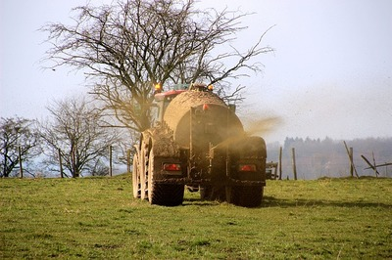
In this Smart Lesson, you will learn how the nitrogen cycle works and why it is threatened by human activity.
⋅ | Identify the steps required for nitrogen to cycle through all four spheres
⋅ | Describe how humans have influenced the nitrogen cycle
⋅ | Explain the consequences of these human influences on the Earth

Slide 3
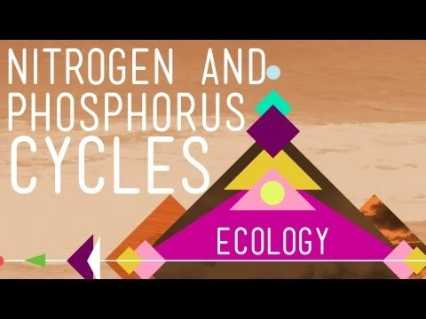

Slide 4
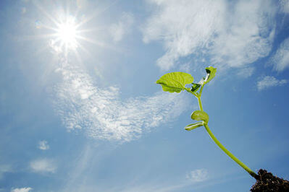
Nitrogen (N₂​) is an element that, in its biological form, is an essential part of nitrogenous bases of DNA and amino acids, the building blocks of proteins.
Although the atmosphere is around 78% nitrogen, this gaseous form is not accessible to most living organisms.

Slide 5
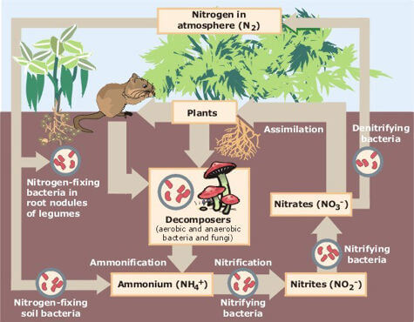
To make atmospheric nitrogen (N_{2​}) accessible to plants, nitrogen undergoes a process known as nitrogen fixation.

Slide 6
Nitrogen fixation is the conversion of nitrogen that has become trapped in the soil, by nitrogen-fixing bacteria.
These bacteria convert the nitrogen (N₂​) into ammonia (NH₃​), which can then be converted into nitrates (NO₃​⁻) by nitrifying bacteria.

Slide 7
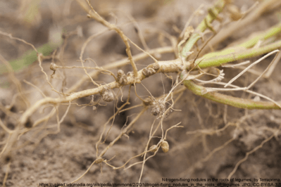
These nitrogen-fixing bacteria have a mutually beneficial relationship with leguminous plants (e.g. peanuts, soya-beans) and form nodules on their roots, as can be seen below (the small bumps on the roots).

Slide 8
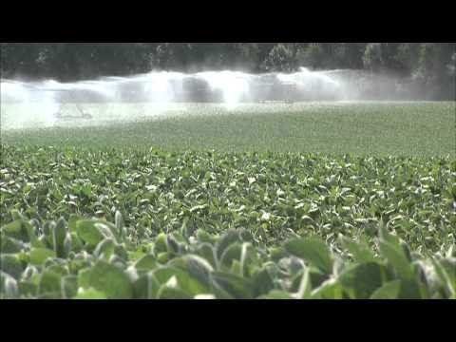

Slide 9
This nitrogen taken up by legumes is either consumed when animals eat the legumes, or is taken up by other plants when the legume dies and decomposes in the soil.
When plants and organisms that gained nitrogen through plant consumption die, they are decomposed by another type of organism known as a decomposer.

Slide 10
These decomposers convert the biological nitrogen to ammonia through the process of ammonification.
Although ammonia can be absorbed by plants, it can be converted to a more readily absorbed form called a nitrate. This nitrate is converted by nitrifying bacteria and the process is known as nitrification.

Slide 11
Following nitrification, the nitrites and nitrates can either be assimilated (taken up by plants) or be converted back into nitrogen, through the process of denitrification. The nitrogen is then released back into the atmosphere, completing the cycle.

Slide 12
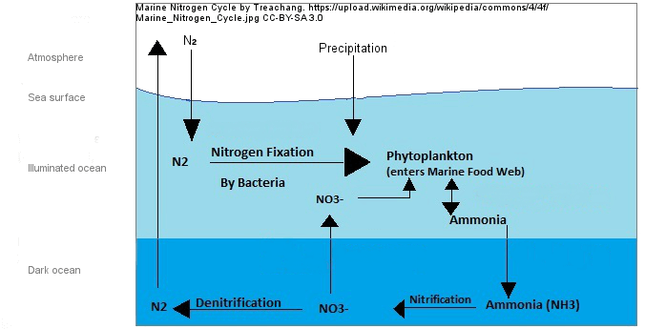
Nitrogen can enter the hydrosphere through rain water run-off (collecting nitrates (NO₃​⁻) from soil), or directly from the atmosphere as nitrogen (N₂​).
N₂​ cannot be absorbed and used by phytoplankton, so it must undergo nitrogen fixation by bacteria to convert it to nitrate (NO₃​⁻), as in the biosphere.

Slide 13
Phytoplankton absorb the nitrates, and excrete ammonia.
From here the ammonia is converted to nitrites, then nitrates, and can either be absorbed by phytoplankton, or released back into the atmosphere as N_{2​} in denitrification, and the cycle can begin again.

Slide 14
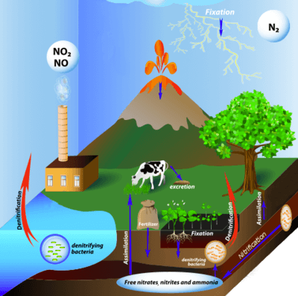
Like phosphorus, nitrogen is also used as a fertiliser to increase plant growth, as it is an important component of nitrogenous bases and amino acids in living organisms.
This has led to an increase in nitrogen circulating within the spheres.

Slide 15
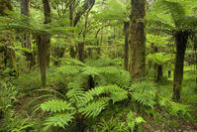
Increased nitrogen levels affect biodiversity, or the range and number of species within ecosystems.
Some plants are used to growing in soils with low nitrogen levels.
So when fertiliser increases the amount of nitrogen in the soil, the species that were previously best adapted to the low nitrogen soil, may be outcompeted by other previously less prevalent plant species that thrive with the increased nitrogen.

Slide 16
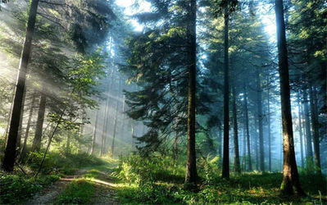
This decrease in plants that thrive on low nitrogen soils will also lead to a decrease in the organisms that consume them, as their food source will become depleted.

Slide 17
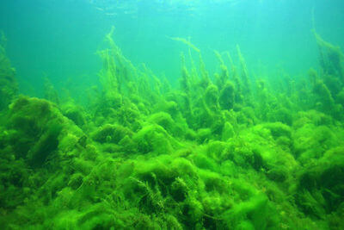
Similar decreases in biodiversity can happen in the hydrosphere.
When excess nitrogen is carried into the hydrosphere through water run-off, the increase in available nitrogen can cause algae populations to boom.
When algae populations increase they can block sunlight to lower level organisms, decreasing their growth or killing them.

Slide 18
Increased algae populations also leads to an increased number of decomposing algae plants, since more will be dying at one time.
When algae are decomposed, they release chemicals that are poisonous to other organisms, including humans, further reducing the biodiversity of that water-body.

Slide 19
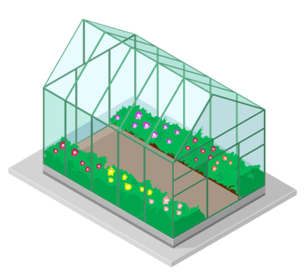
Fertiliser has another downside. The increased nitrification and denitrification of nitrogen compounds has led to increased natural nitric oxide (NO) and nitrous oxide (N_{2​}O) emissions.
Nitrous oxide is a greenhouse gas, which traps heat in Earth's troposphere even more efficiently than CO₂​.

Slide 20
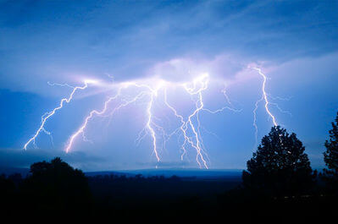
Lightning can also cause nitrogen fixation, as it splits apart nitrogen atoms and produces nitrites and nitrates (NO₂^{​−} and NO_{3​}⁻).
This is because great amounts of heat and energy are needed to split apart the triple covalent bond of N₂​.

Slide 21
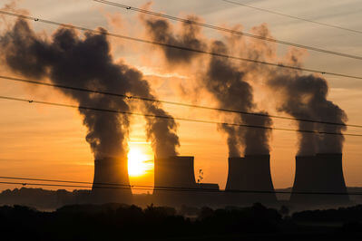
In a similar process to that of lightning, burning fossil fuels creates high temperatures and pressures. These conditions produce enough energy to convert nitrogen gas (N₂​) to nitric oxide gas (NO).
If the fossil fuels being burnt contain fossilised nitrogen, this can also become reactive and increase NO emissions.

Slide 22
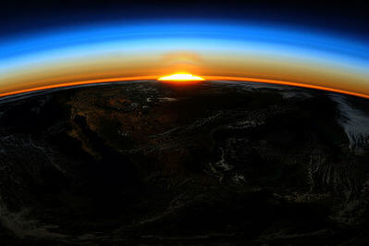
When NO reaches the ozone layer, it can react with ozone O_{3​}, to produce nitric dioxide NO₂​ and oxygen O₂​.
This process depletes the amount of ozone in the atmosphere. Depletion of ozone reduces the thickness of the ozone layer, allowing increased amounts of ultraviolet radiation (UV) to reach Earth. Exposure to high amounts of UV is known to cause skin cancer.

Slide 23
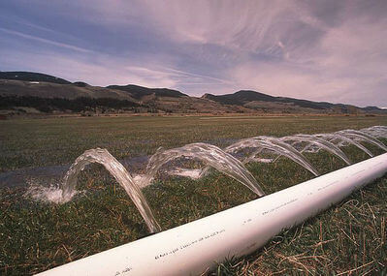
Nitrous oxide (N2​O) has increased drastically since the Industrial Revolution. Nitrous oxide in the atmosphere has increased from 270 nanomoles per mole before the Industrial Revolution around 200 years ago, to around 319 nanomoles per mol in 2005.
In addition, human activity accounts for over 33% of N₂​O emissions, and most of this is through agriculture.

